Slide 1
A Quantitative Analysis and Guidelines of Data Streaming Accelerator in Modern Intel® Xeon® Scalable Processors
Reese Kuper¹, Ipoom Jeong¹, Yifan Yuan², Ren Wang², Narayan Ranganathan², Nikhil Rao², Jiayu Hu³, Sanjay Kumar², Philip Lantz², Nam Sung Kim¹
1: UIUC, 2: Intel Labs, 3: Tencent
ASPLOS 2024
Notes:
Hi Everyone, today I’m going to talk about the Intel data streaming accelerator or DSA, an on-chip accelerator on Modern Intel Xeon CPUs for data transformations. This is a joint work between Intel and university of Illinois.

Slide 2
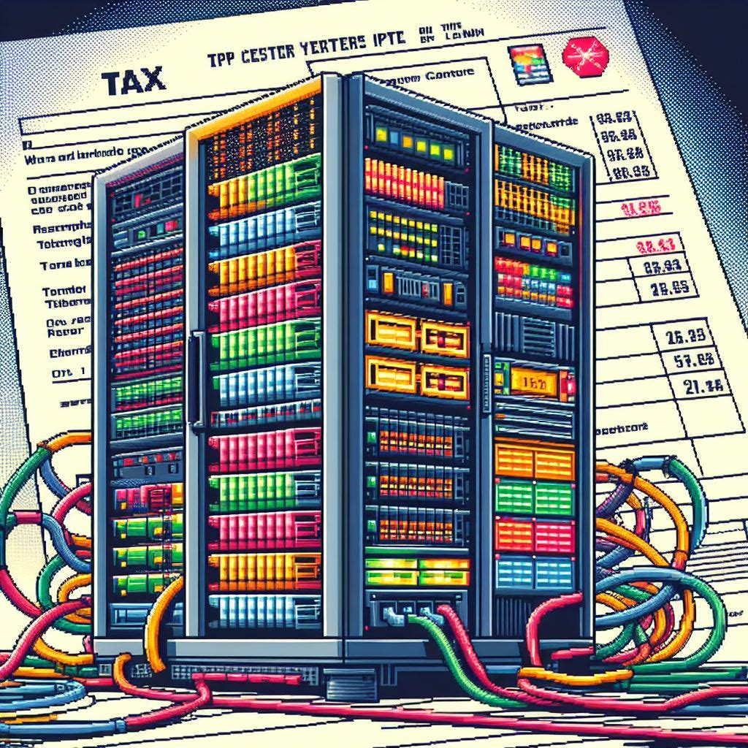
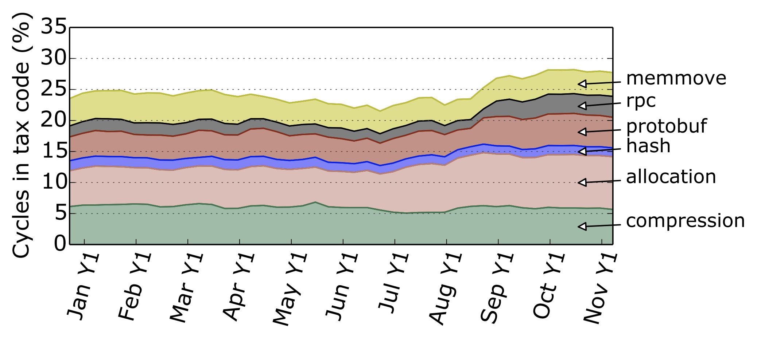
Datacenter and Systems Taxes
The cost of CPUs running fundamental infrastructure and systems software
The tax has been important as datacenters scale up in size and complexity
Profiling a warehouse-scale computer, ISCA 2015
Notes:
In modern datacenter, the datacenter and systems tax has become a big problem.
It refer to the CPU cycles used for fundamental infra and software routines, which could have been spent on the actual applications and workloads.
Identified by Google back to 2015, datacenter and systems tax includes but are not limited to memmove, rpc, protobuf, hashing.

Slide 3
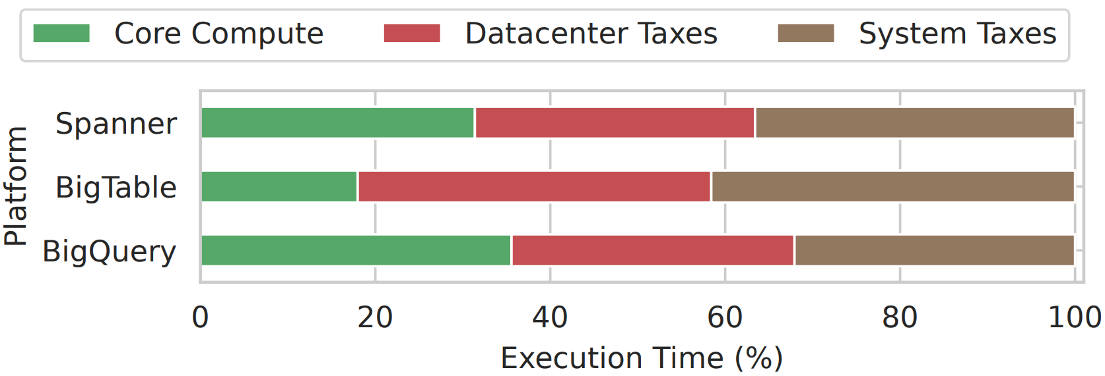
Datacenter and Systems Taxes
There’s been a tax inflation over time!
27% to more than 40% CPU cycle consumption today
Intel DSA is set to reduce a critical tax – data transformation
Profiling a warehouse-scale computer, ISCA 2015
Profiling a Hyperscale Big Data Processing, ISCA 2023
Notes:
To make thing worse, there’s been a tax inflation over the past decade.
As disclosed by google last year, in many scenarios, the tax rate surges significantly from around 25 percent to more than 40 percent!
As an attempt to reduce a critical tax – data transformation., Intel has designed and implemented data streaming accelerator (DSA).

Slide 4
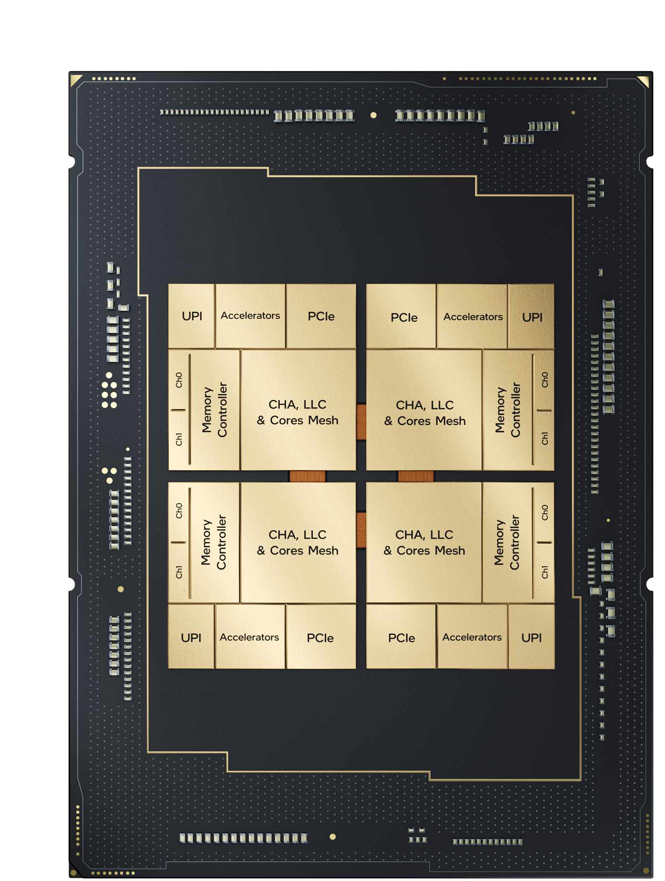
Intel Data Streaming Accelerator (DSA)
An on-chip accelerator in modern Intel Xeon CPUs to for data transformation
Data move, fill, compare, flush, CRC, and more
Cache-coherent
High performance and scalability
High per-instance-throughput, with low latency
Scalable to support multiple users
User-Friendly
Simple and flexible programming models
Rich software ecosystems
Can be application-transparent
Intel® DSA
Notes:
DSA is an on-chip accelerator in the Intel Xeon CPU package and can do various data movement and transformation operations.
DSA can provide high throughput with low latency for the transformation operations, and can be scaled to support many users
DSA is also user-friendly, and can be even application-transparent.

Slide 5





DSA Unique Features
Efficient Core-accelerator Interaction
Virtualization and Multi-tenant Support
Batch Processing
QoS Control
Bandwidth provisioning, bandwidth cap across group
Work dispatch priority, traffic classes
Simple descriptor-based job submission and completion
New x86 instructions for submission and completion check
Shared virtual memory space with CPU, no need for explicit memory management
Can be used by multiple tenants in a scalable way
Capabilities of processing a batch of descriptors, reducing job submission overhead
Notes:
As a new IP on modern Intel Xeon processors, DSA has several unique features that facilitate its deployment and usage.
The first one is its efficient core-accelerator communication. Software uses simple descriptor to submit task to DSA, and this can be done with new x86 instructions
The second one is virtualization and multi-tenant support. DSA supports shared virtual memory, meaning the software doesn’t need to manage the memory explicitly, such as pinning a specific page. Also, multiple tenants can easily share a single DSA instance.
Third, DSA supports processing the tasks in a batch. This reduces the task submission overhead.
Last, DSA has rich QoS control support, from bandwidth provisioning, to descriptor priority. This can be easily tuned by the software.

Slide 6
DSA Architecture and Interface
Group
I/O fabric interface
MMIO registers to software
Update
config
Address translation
Memory access
Submit work
Front end: hardware work queues
Back end: Engines for single/batch operations
WQ config
ATC
Memory R/W
Portals
WQ 1 (shared)
Engine 1
WQ 2 (dedicated)
Arbiter
WQ 3
Engine 2
···
···
WQ N
Engine M
Notes:
Let’s dive deep into DSA’s hardware architecture.
The front end of DSA is a set of queues called work queues or WQ. They are responsible for receiving task descriptors from the CPU software.
They are exposed to the system as MMIO registers, or “portals”.
And the software can write descriptor to these portals, and the descriptors will be queued into corresponding WQs.
The backend of DSA is a set of processing engines.
There is an arbiter connecting the frontend and backend for QoS purpose,
And we can flexibly configure WQs and engines into different groups.
This is done via the out-of-band configuration interface.
And we also have interface and structures for virtual-physical address translation,
And memory requests.

Slide 7
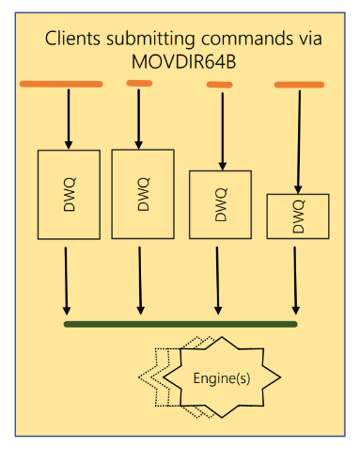
DSA Architecture and Interface
Dedicated Work Queue (DWQ)
Used by a single client (process or VM)
Descriptor submission via MOVDIR64B (64B atomic posted write to a 4KB MMIO region)
Software responsible for managing DWQ occupancy
Notes:
Here is a deeper explanation of the WQs.
First is DWQ.
It’s intended to be used by single client, which can be either a process or a VM
A user can use the new MOVDIR64B instruction to write the descriptor to the MMIO region with low overhead
Also, the software need to manage the queue occupancy, or say, how many on-the-fly descriptors should be issued.

Slide 8
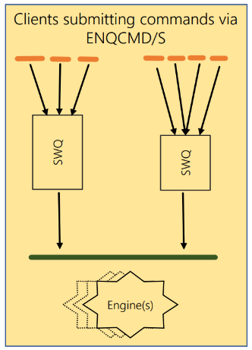
DSA Architecture and Interface
Shared Work Queue (SWQ)
Used by multiple clients
Descriptor submission via ENQCMD (64B atomic non-posted write)
ENQCMD returns status of SWQ occupancy (accept/reject)
Notes:
Different from DWQ,
Shared work queue or SWQ is intended to by used by many clients.
The software can use the new ENQCMD to write descriptors, without explicitly managing the inter-client contention.
The ENQCMD instruction returns a status of whether the descriptor is accepted by the SWQ HW.

Slide 9
Intel DSA Programming Models
Do next compute task
Do next compute task
Do next compute task
zzz
CPU
CPU
CPU
Intel DSA Descriptor
Intel DSA Descriptor
Load from mem
Load from mem
Store to mem
Load from mem
Store to mem
Load from mem
Store to mem
Load from mem
Done
Done
Memory
Memory
Intel DSA
Memory
Intel DSA
Store to mem
Store to mem
A
Pure Software
B
DSA Sync Mode
C
DSA Async Mode
Notes:
DSA expose two programming models to the software users.
Let’s see pure software first. In software, you have to issue instructions to load from to store to the memory, and then start the next task
With DSA sync mode, the CPU can simply submit the descriptor to the DSA HW, and while waiting for the DSA to complete the task, the CPU is keeping idle, or entering some low-power state. The CPU can move on to the next task, upon the completion of DSA task, which can be notified by interrupt of polling.
With DSA async mode, after submitting the descriptor to the DSA HW, the CPU can continue to work on the next task simultaneously. The next task can be software running on the CPU, or another DSA descriptor to the DSA HW.

Slide 10







Intel DSA Software Stacks and Enablements
Applications
Media Transport Lib
NVMe- oF​
Frameworks
SPDK
VPP
Libraries
OFI Libfabric
Intel ® MPI
Intel® DML
Intel ® DTO
Virtualization
(Guest)
QEMU / KVM
OS & Kernel (Host)
Linux
RedHat
Ubuntu
SLES15 SP4
Azure Host
Notes:
Regarding software enablement, collaborating with the open-source communities, we’ve built rich DSA ecosystems all the way from OS, VMM, libraries, frameworks, to upper level applications.

Slide 11
Intel DSA Software Stacks and Enablements
Intel® DML
Data mover Library
High-level APIs for users to take advantage of DSA
Hiding hardware details
Intel ® DTO
DSA Transparent Offloading Library
Users can use DSA transparently (with configuration/tunning knobs)
NO code modification/re-compilation!
Notes:
And I want to highlight two libraries that facilitate DSA’s adoption in applications. They are DML and DTO
DML, stands for data mover library.
It provides a set of high-level APIs for user, hiding the low-level DSA hardware details
DTO is DSA transparent offloading library
It intercepts the default system functions like memcpy and replace them with the corresponding DSA functions adaptively. User don’t even need to recompile their program!

Slide 12
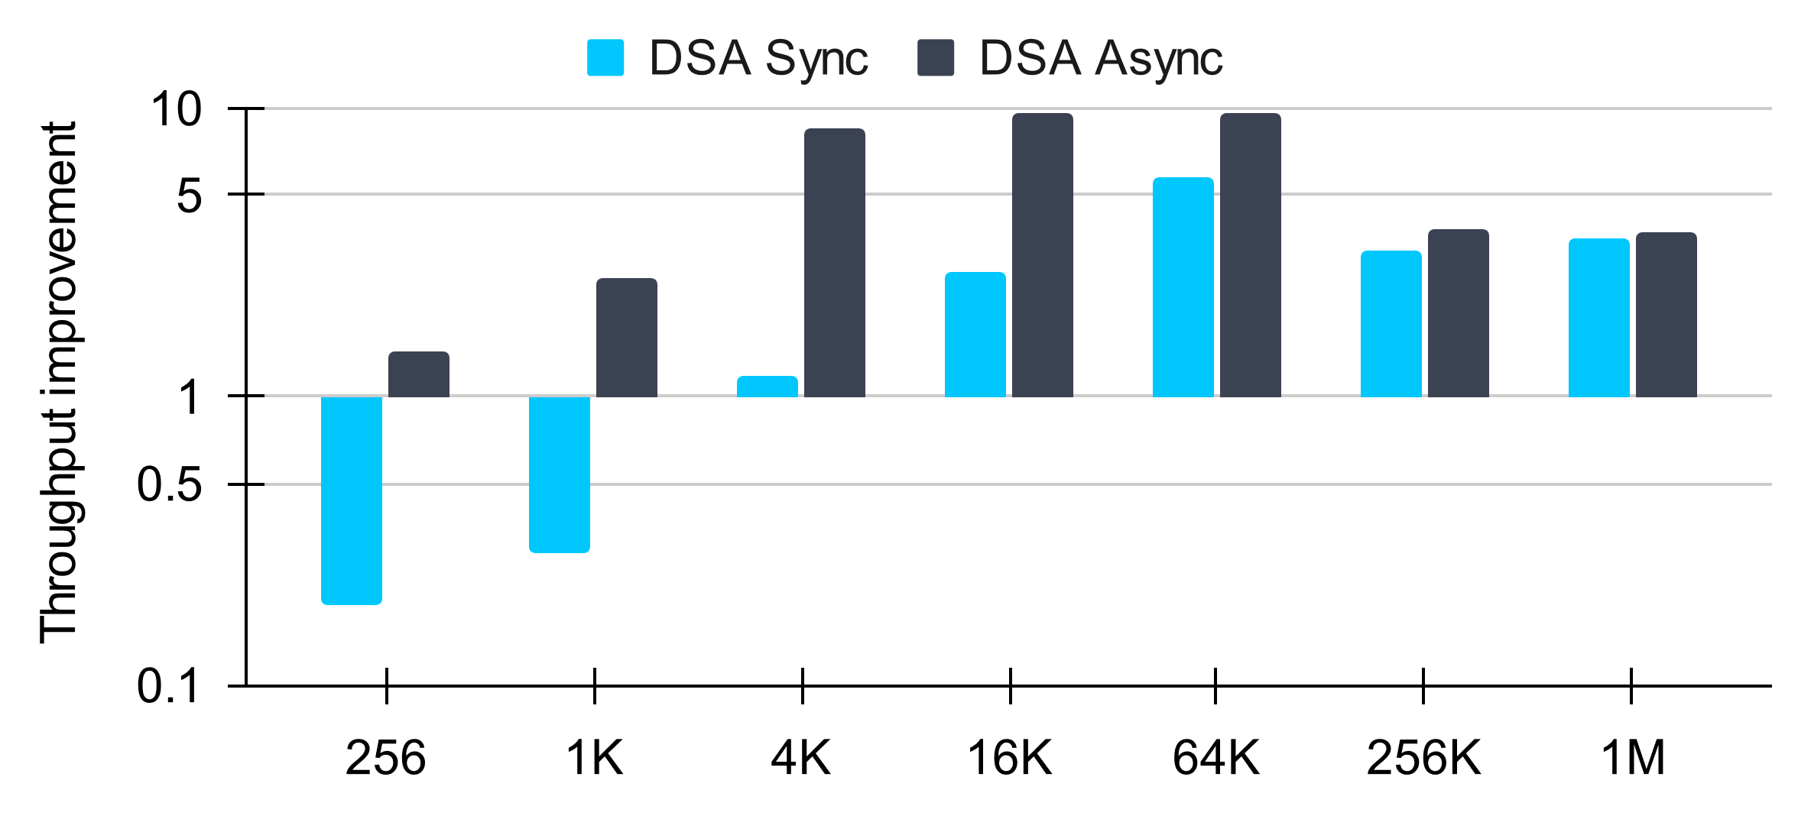
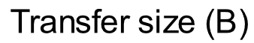
Performance: Throughput Improvement vs 1 CPU core
DSA can offer more than 5-core savings
DSA async provides more benefits
Notes:
Let’s look at some performance numbers of DSA. These numbers are measured from the open-source DSA-perf-micros benchmark on an Intel 4th gen Xeon processor.
For simplicity we only show the memory move performance in this presentation.
The first plot show the throughput of a single DSA instance, normalized to that of a single CPU core.
As we can see, as long as the data transfer size is not very small, DSA always has notable throughput benefit over CPU core, and this can lead to as high as 5 CPU core saving.
Also, since more tasks are processed by the DSA HW, operating DSA in async mode always provides more benefits. But this may require more software changes.

Slide 13
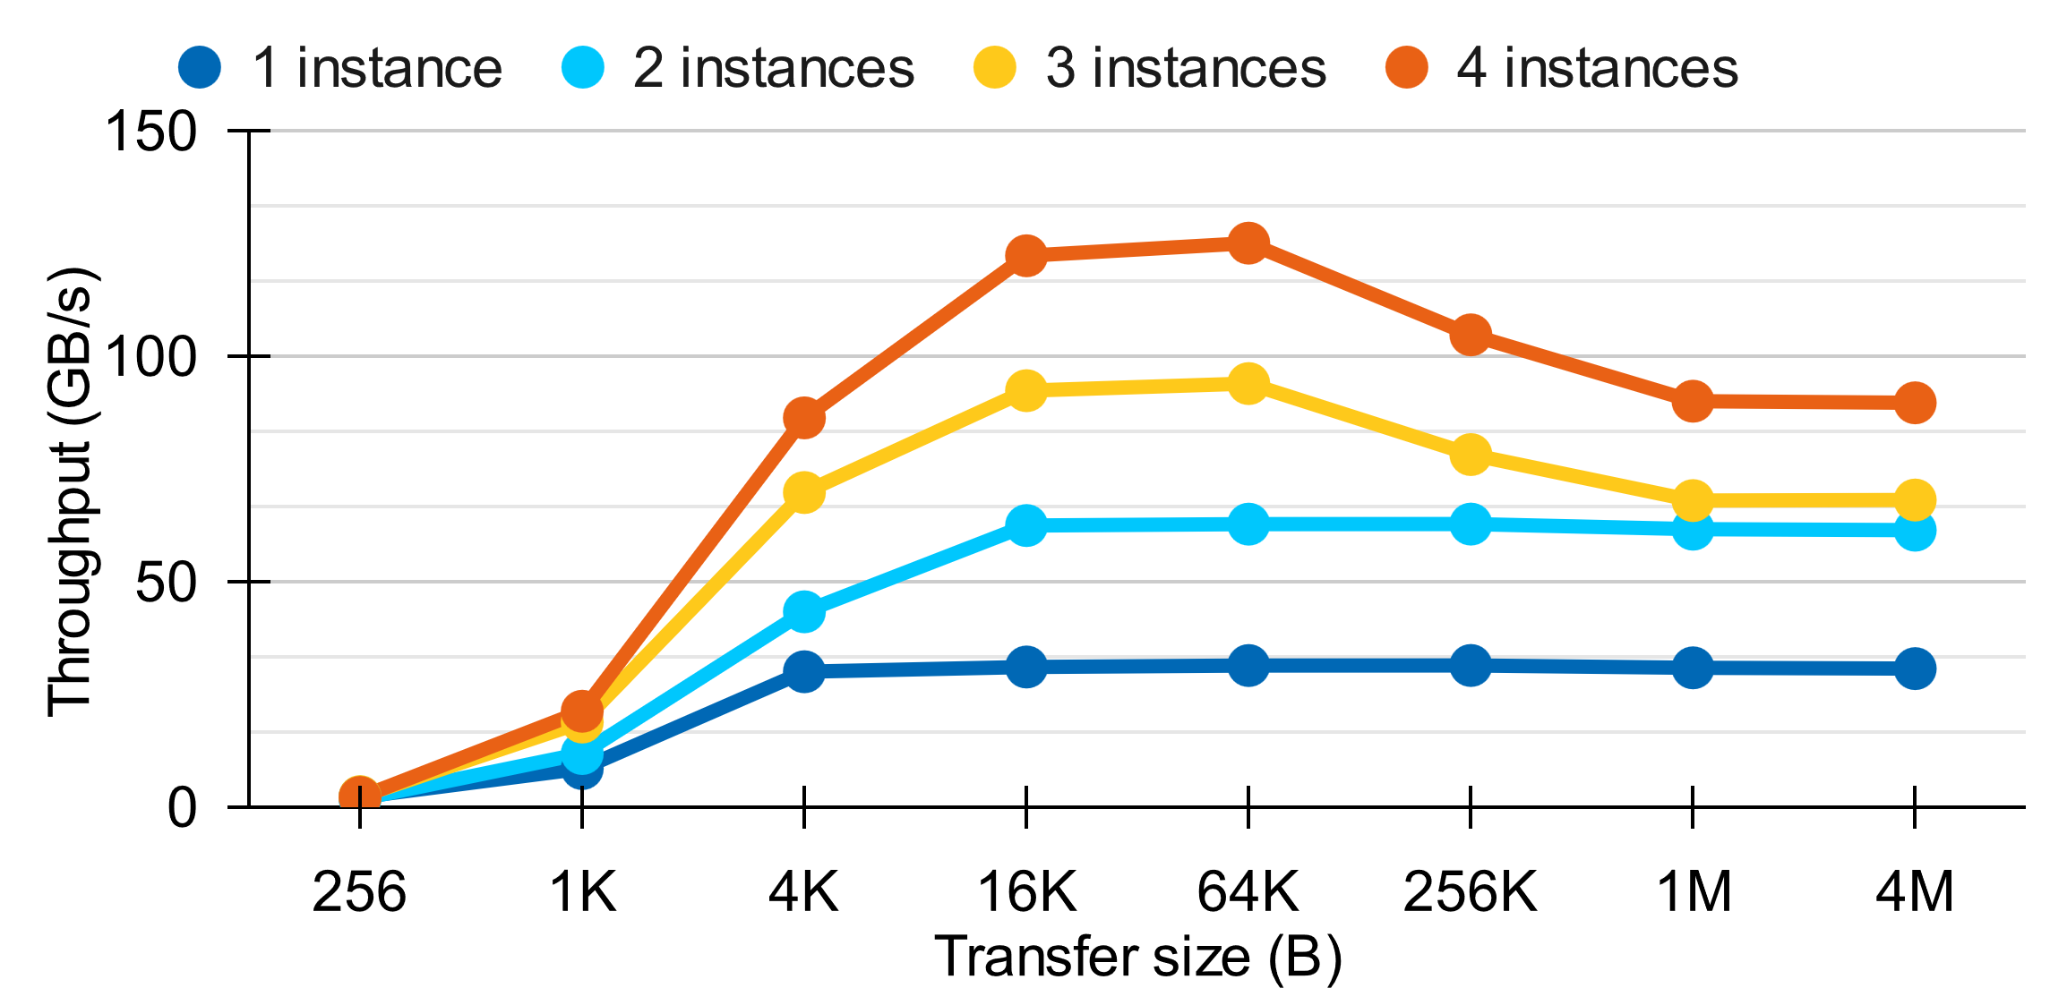
Performance: Aggregate Throughput with More Instances
DSA shows good performance scalability with multiple instances
DRAM BW may limit DSA’s performance in extreme cases
Data representing DSA bandwidth in each direction
Notes:
Let’s then see how DSA performance can scale with multiple instances on the same CPU package
As we can see, the aggregate throughput scale almost linearly with the number of DSA instances
Note that, in some extreme cases, the DSA aggregate throughput is limited by the system memory bandwidth, as more data is trashed to the DRAM, instead of DDIO-ed to the last-level cache

Slide 14
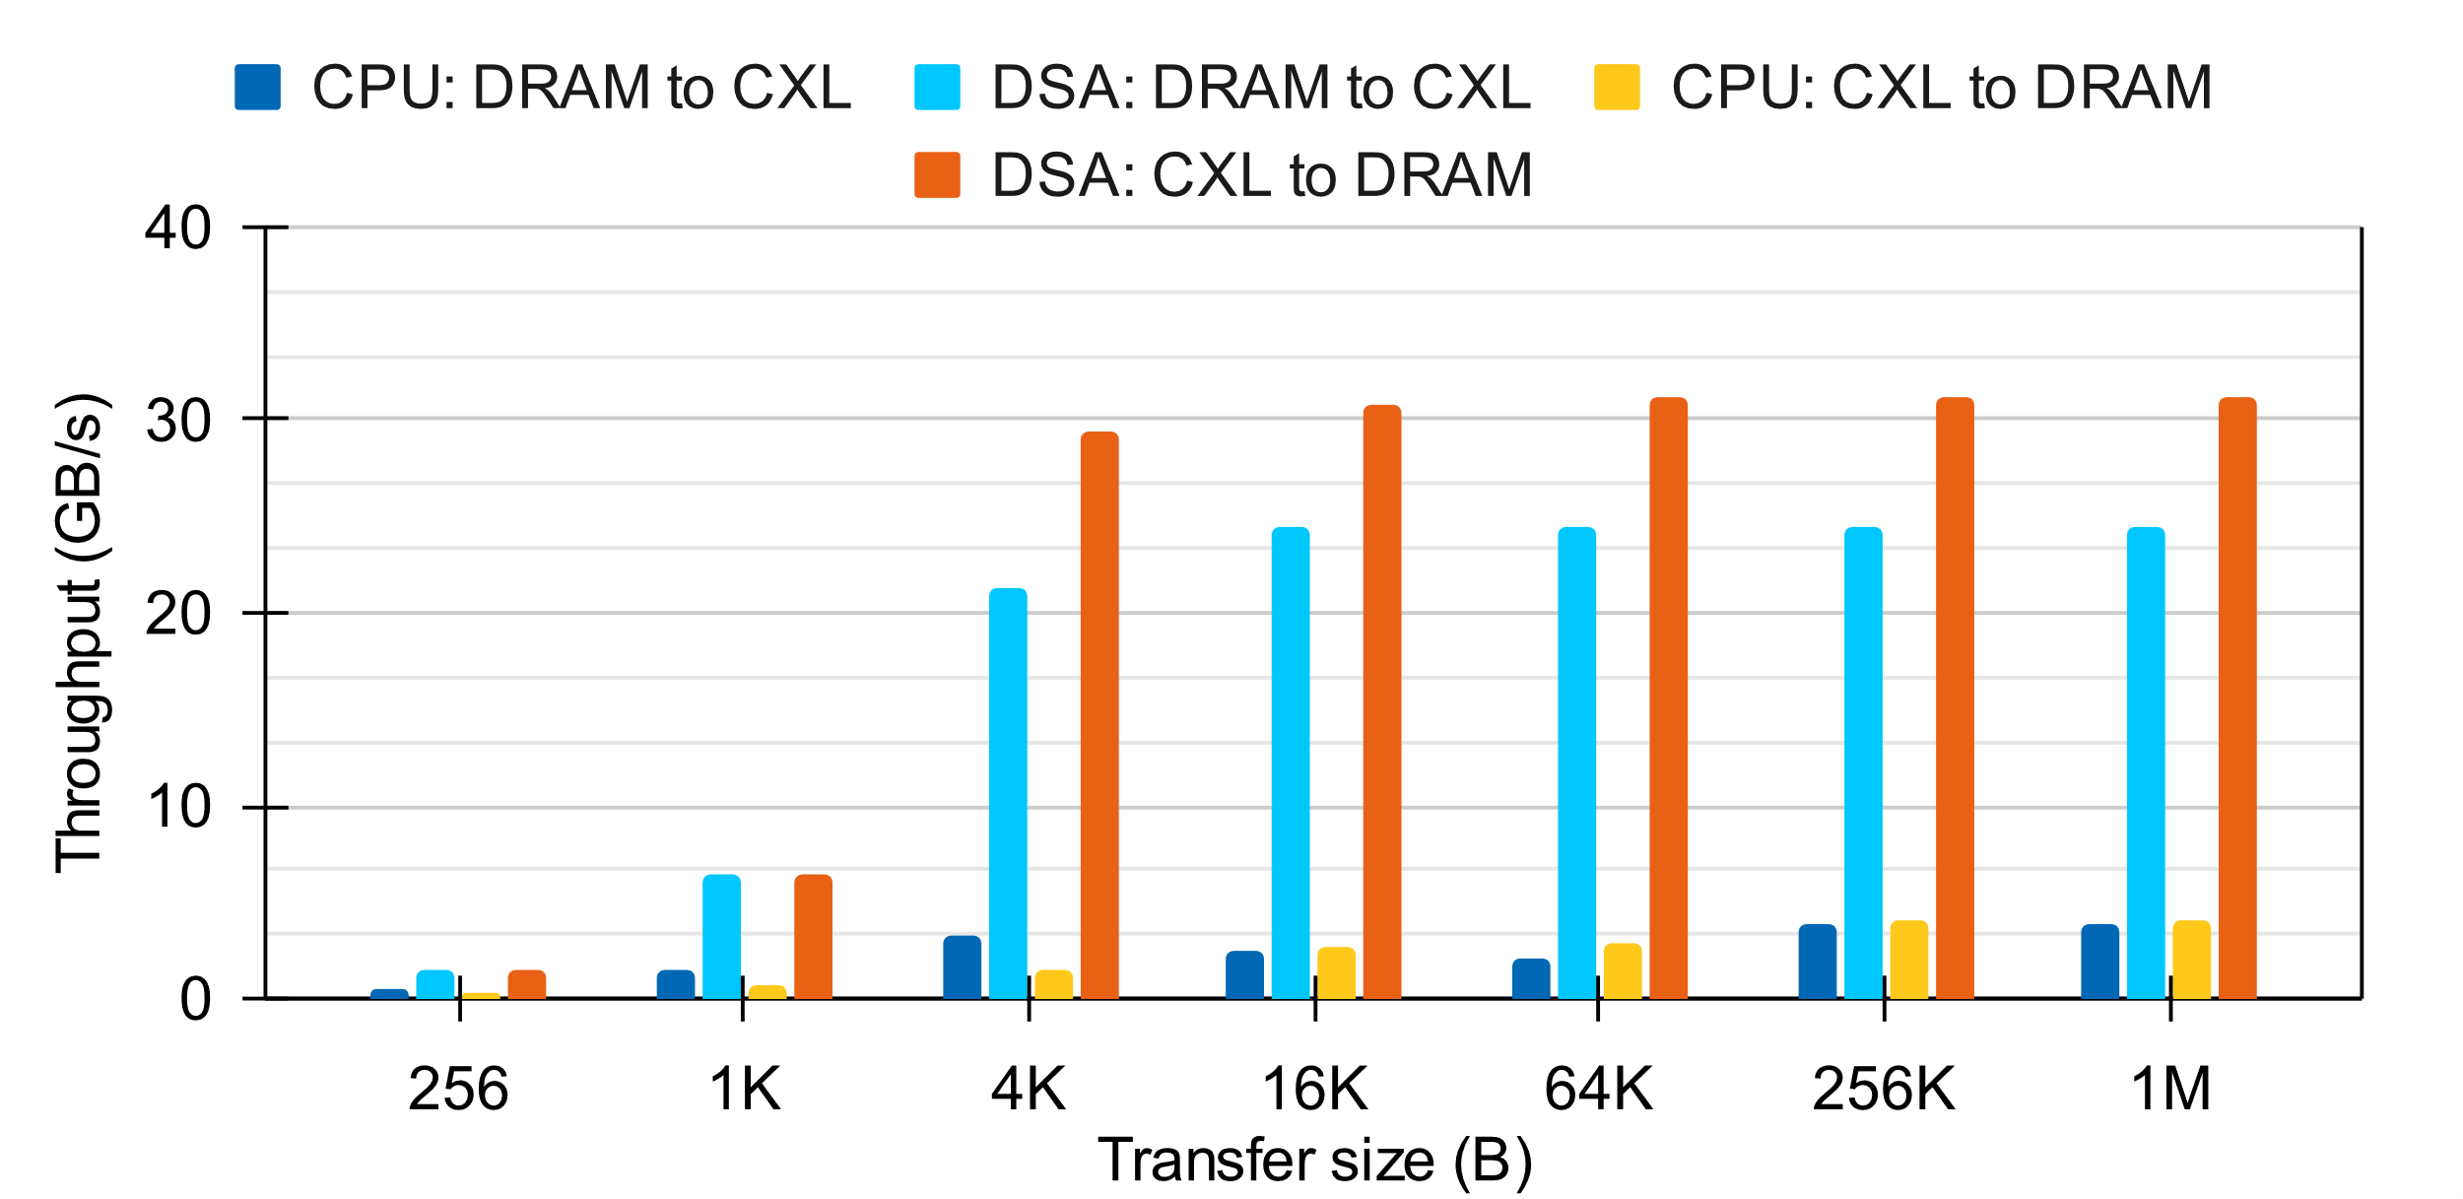
Performance: Working with CXL Memory
For CXL-related data movement, DSA shows great benefits
DSA is more latency-tolerant, unlike LSQ being saturated in core
Data representing DSA bandwidth in each direction
Notes:
Next, let’s see how DSA can benefit CXL memory.
CXL memory is an emerging technique that expand the memory capacity with a secondary but slower memory tier.
In this plot we show the throughput of CPU and DSA for data transfer between the host DRAM and CXL memory.
In these cases, DSA shows even larger benefits over CPU cores, showing its great potential in modern tiered memory management.
This is because DSA is more latency-tolerant, while the CPU core has to wait the outgoing memory requests in the load-store queue, limiting its parallelism.

Slide 15
More Details in the Paper
DSA software (driver) architecture
More aspects of DSA performance
Latency, batching, intra-instance parallelism, CPU utilization, cache occupancy, DSA vs predecessor
DSA use cases and software libraries
DML for easy usage
Networking, storage, HPC/ML, memory management, etc.
DTO for application-transparent usage, with Cachelib as example
Notes:
To learn more about DSA’s architecture, performance, and software support, please see the paper for more details.

Slide 16

Make the Most out of DSA:
“All look great, but I don’t want to put lots of efforts changing my app before making sure DSA can help me……”
Our recommendation is to take a step-by-step optimization:
Try DTO with your app first. It’s painless
If it helps and you want more improvement, replace your routines with DSA APIs (like DML)
Still want more? Analyze your app and consider different programming models (requires more efforts in your code)
Notes:
Having all said, you may think “hey, this is cool! But how can I know I can benefit from DSA, I don’t want to get my hands dirty immediately…”
That’s a great question. So here we suggest a step-by-step usage of DSA with little pain.
First, you can try DTO that transparently offloads tasks to DSA for you. It’s painless and just requires a couple of configuration.
Then, if you want more control and more benefit, you can consider the DML APIs in your code.
And finally, if you really want to squeeze every cycles out of DSA, changing programming models can be a good thing to try.

Slide 17
Make the Most out of DSA: An Example with Guidelines
DPDK Vhost
VirtIO backend implementation for VirtIO network devices
widely used in software switches for VMs
Notes:
Then let’s take a specific example to see how DSA, with guidelines, can be adopted and benefit a real-world application.
Here we choose DPDK Vhost, a VirtIO backend implementation for virtual network devices
And it’s widely used in software switches for VMs.

Slide 18
Make the Most out of DSA: An Example with Guidelines
DPDK Vhost
VirtIO backend implementation for VirtIO network devices
widely used in software switches for VMs
Intel DSA can help accelerate packet copies in DPDK Vhost, between VMs and software switch
Notes:
And DSA can be used for data movement between VMs and software switch

Slide 19
Make the Most out of DSA: An Example with Guidelines
Use async programming models when possible.
Apply it at virtio’s enqueue/dequeue logic
Right-size batch and each job
Take advantage of DSA hardware configurations.
Apply multiple engines for parallelism
Bind DWQs to each thread (core) to avoid locking overhead
Interaction with cache/mem
Based on good temporal locality in DPDK Vhost, put data directly to LLC
Notes:
We have several guidelines for software developers,
Some of them are about the programming model, and task size,
Some are about the DSA HW configurations like engines and SWQ/DWQ usages,
And some are about the right way to interact with cache and memory hierarchy

Slide 20
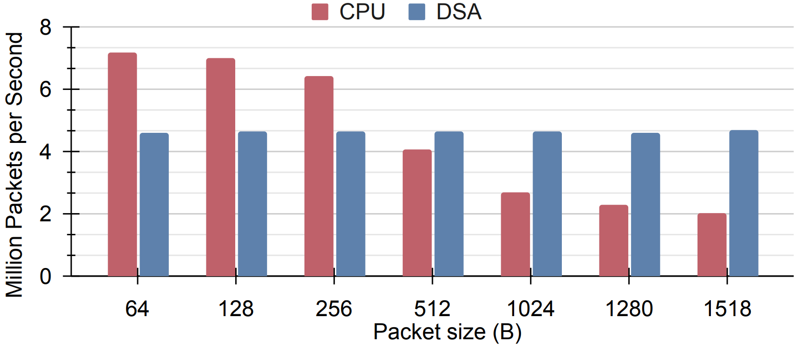
Make the Most out of DSA: An Example with Guidelines
Applied the guidelines, we observe significant packet forwarding rate improvement with Intel DSA.
Notes:
With those guidelines applied in the DSA adoption to Vhost, we see significant packet processing improvement compared to CPU, where DSA can help process packets with different sizes at a constant rate.

Slide 21
Conclusion
Intel DSA opens a new chapter of Intel’s efforts on datacenter taxes reduction.
High-performance, flexible, versatile
Easy-to-use, with broad (open-source) software ecosystems
This paper provides comprehensive characterization and guidelines of DSA usages, paving the way for future research and development.
Having been applied in networking, storage, tiered memory, HPC, and ML, we anticipate and encourage more novel DSA usages in the community!
Notes:
To conclude, Intel DSA is here in modern Intel Xeon processors to reduce the datacenter taxes, providing strong performance and ease-of-use.
This work provides a comprehensive introduction, performance characterization, and guidelines of DSA usage.
And we hope this can pave the way for broader adoption, more novel usage, and more research of DSA in the community.
Thanks for your attention, and I’m happy to take questions.

Slide 22
Notices & Disclaimers
Performance varies by use, configuration and other factors. Learn more on the Performance Index site.
Performance results are based on testing as of dates shown in configurations and may not reflect all publicly available updates. See backup for configuration details.
No product or component can be absolutely secure.
Your costs and results may vary.
Intel technologies may require enabled hardware, software or service activation.
Availability of accelerators varies by SKU. Visit https://ark.intel.com/content/www/us/en/ark/products/series/228622/4th-generation-intel-xeon-scalable-processors.html
Intel does not control or audit third-party data. You should consult other sources to evaluate accuracy.
© Intel Corporation. Intel, the Intel logo, and other Intel marks are trademarks of Intel Corporation or its subsidiaries. Other names and brands may be claimed as the property of others.

